Slide 1
BASIC GEOMETRICAL IDEAS WORKSHOP BY SUDHA BALAKRISHNAN

Slide 2
UNDERSTANDING ELEMENTARY SHAPES

Slide 3
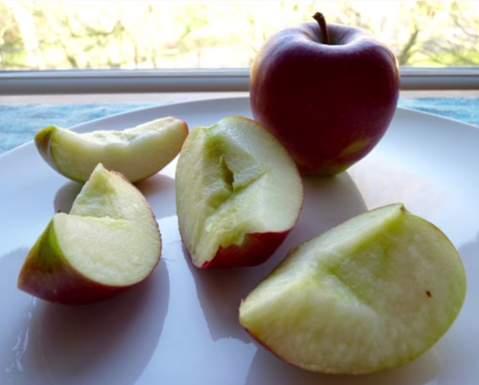
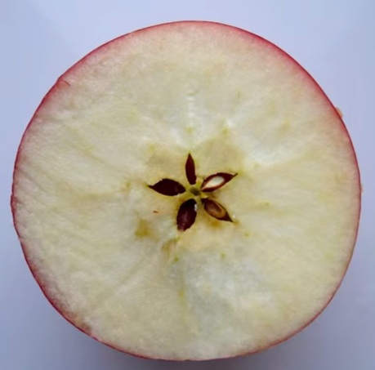
WHICH IS BETTER?

Slide 4
SHAPES IN NATURE
1

Slide 5
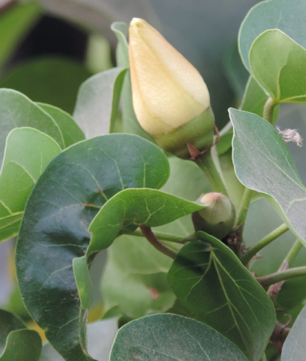
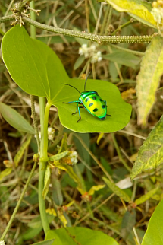
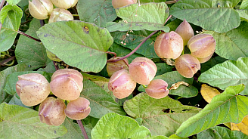
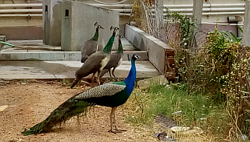
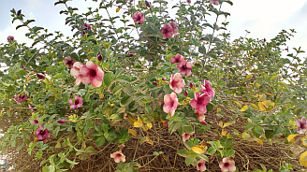
The origin of geometry lies in the concerns of everyday life
J.L.Heilbron

Slide 6
THIS IS A RIDDLE
How do you think they marked their territory/ drew their boundary?

Slide 7
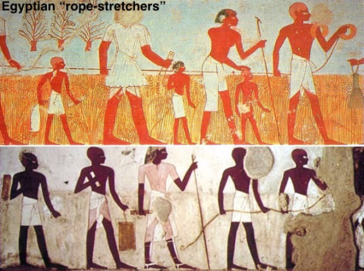
IN GREEK
GEO: EARTH
METRON: MEASURE

Slide 8
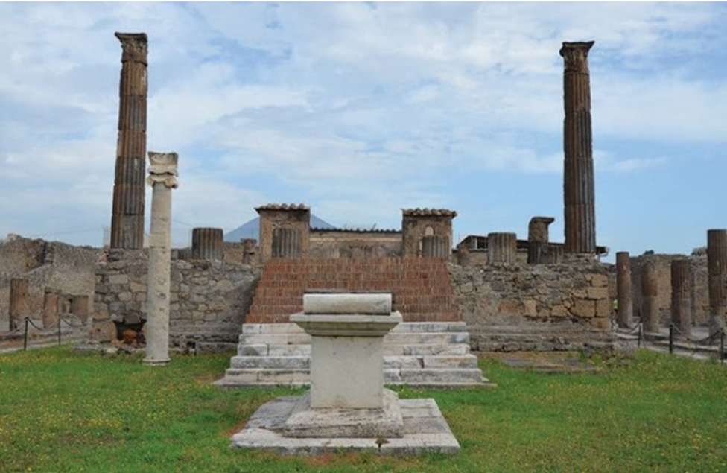
STORY OF THE ALTAR

Slide 9
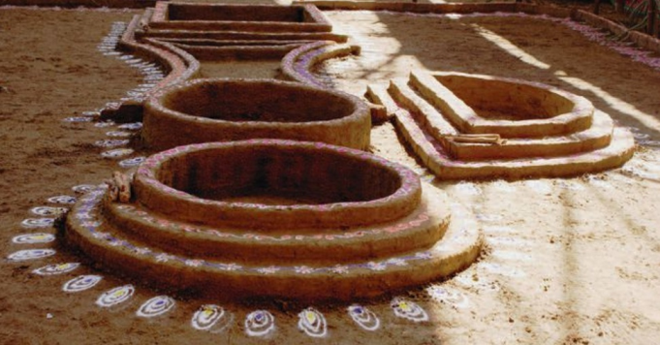
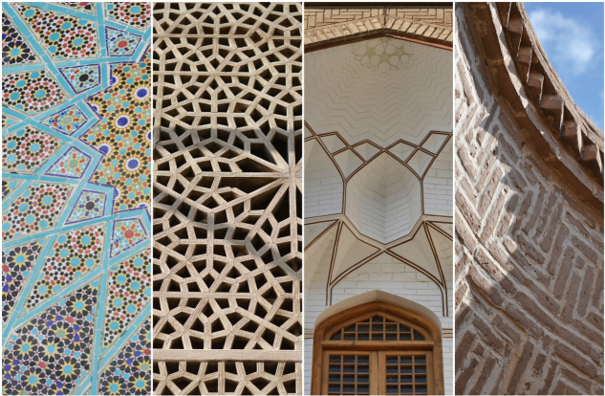
WHERE HAVE YOU SEEN SUCH SHAPES?

Slide 10
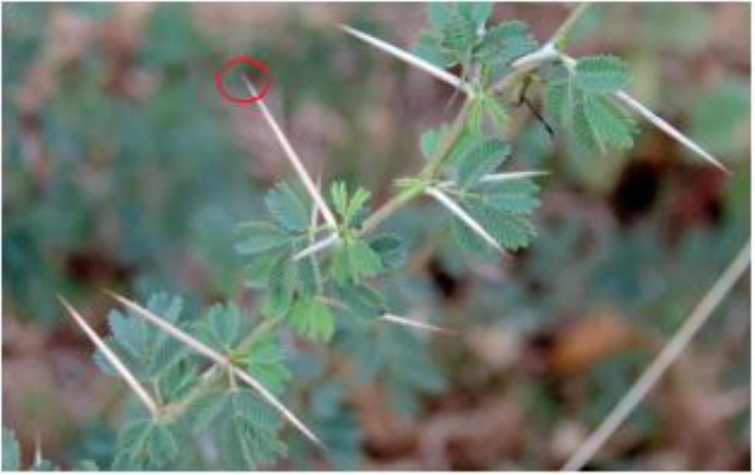
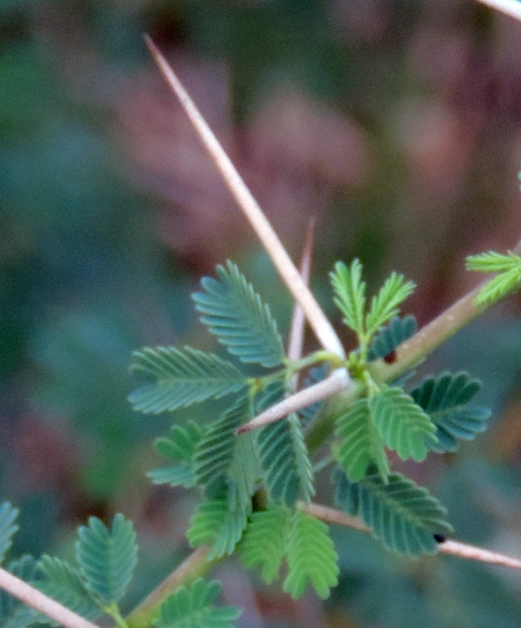
A POINT
The sharp tip of a thorn gives an idea of a point which
has no parts, but has only a position, without dimensions.

Slide 11
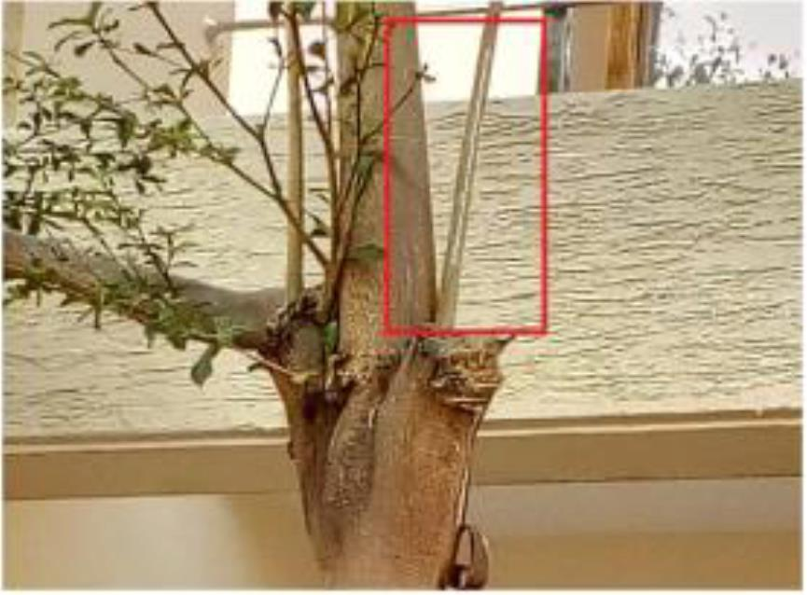
A LINE SEGMENT
The branch of a tree, a shoot of bamboo suggest a line segment
that lies evenly between it’s ends. It is also the shortest route
from one end to the other.

Slide 12
A LINE
Why can’t I draw a line?
A line is a line segment extending endlessly in both directions.

Slide 13
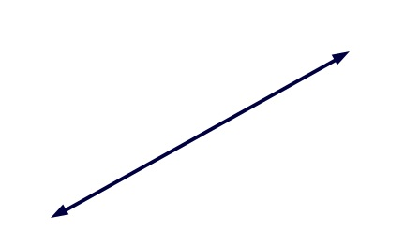
A LINE

Slide 14
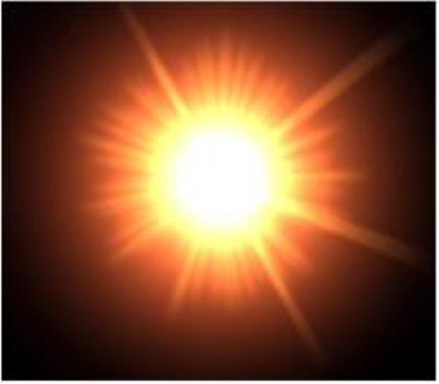
A RAY
What comes to your mind when we speak of a ray?
The Sun’s rays!
A ray is a line which starts at one point and goes endlessly in one direction.

Slide 15
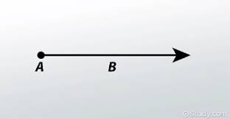
POINT TO RAY
A POINT
LINE SE

Slide 16
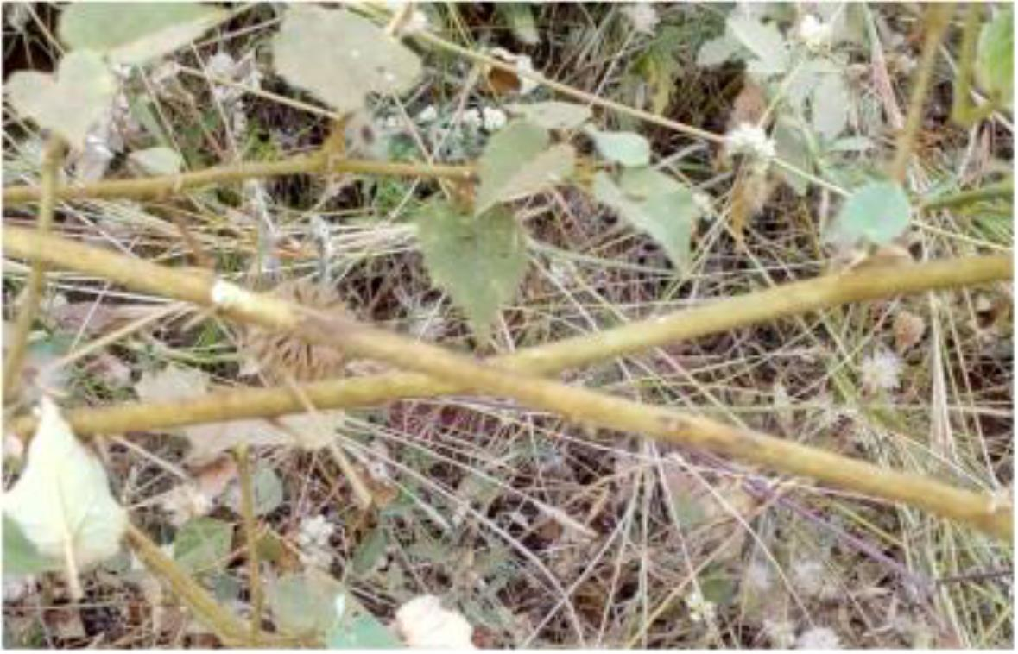
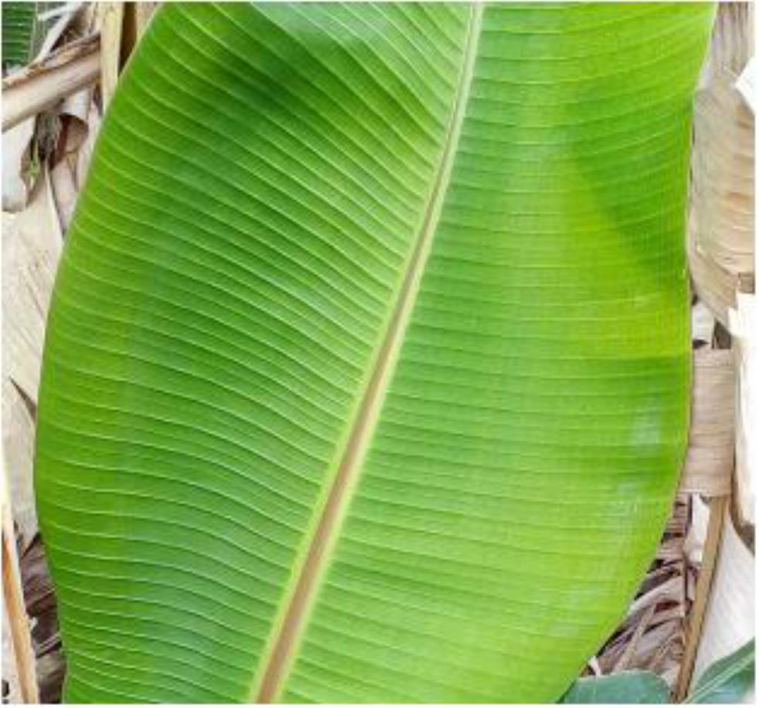
DIFFERENT TYPES OF LINES
Two lines passing through a common point.
They don’t meet.
Where else can you see such lines?

Slide 17
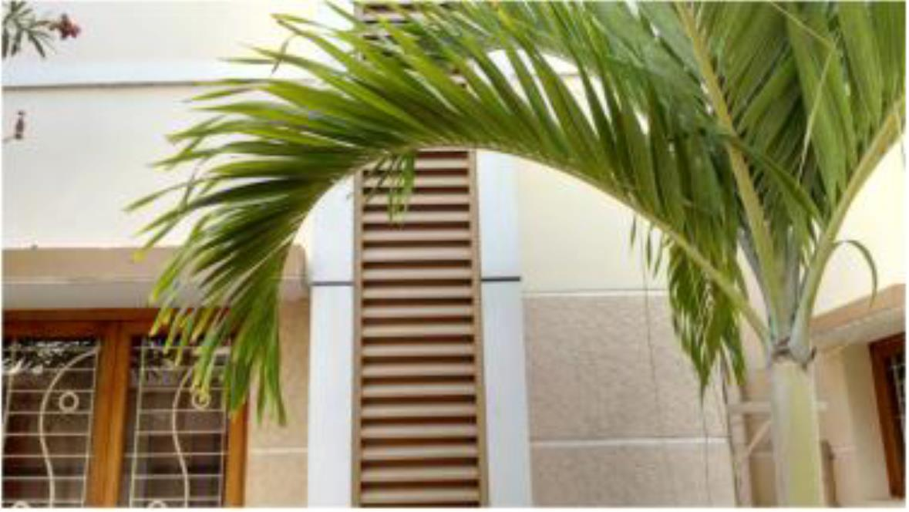
DIFFERENT TYPES OF CURVES
The above is an example of a curve.

Slide 18
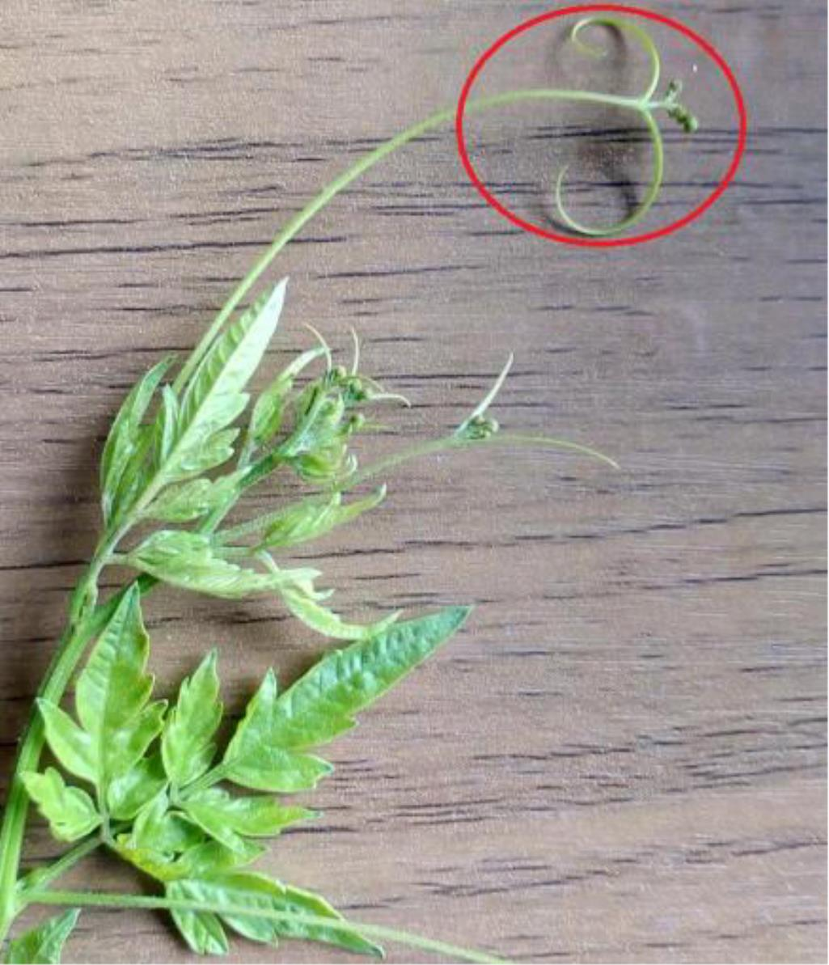
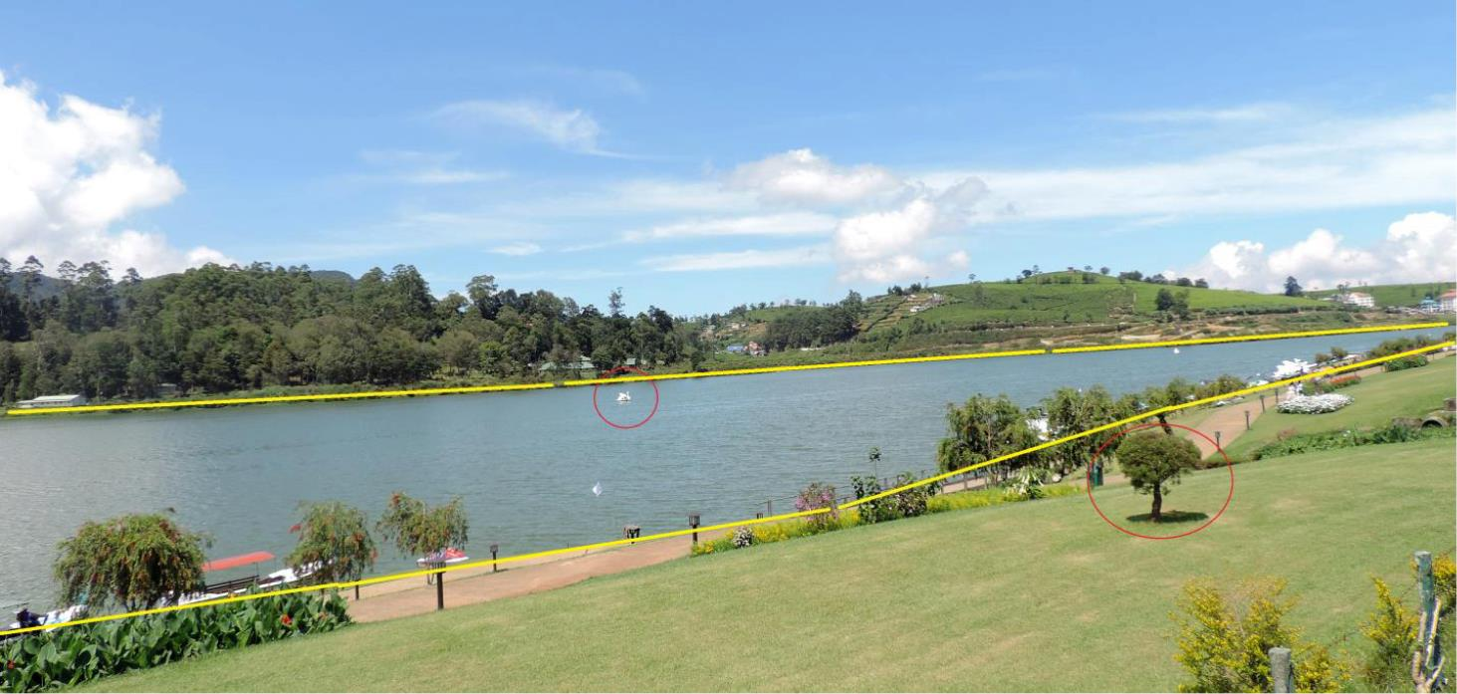
SIMPLE CLOSED CURVE
The boundary of this lake ( marked in yellow)
is a simple closed curve.
The boat (encircled in red) is in the interior of the curve.
The tree ( encircled in red) is in the exterior of the curve
SIMPLE OPEN CURVE

Slide 19
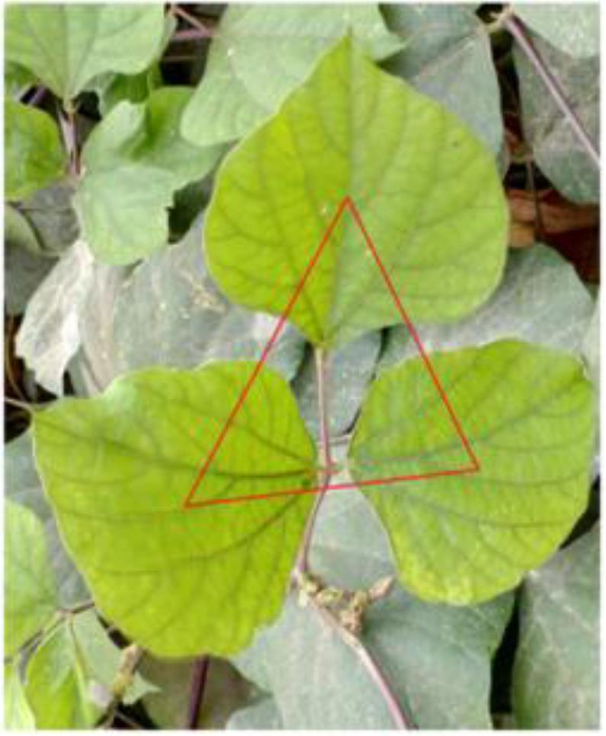
WHAT DO YOU GET?
A Polygon is a simple closed figure made up of line segments.
The centre point of these 3 leaves when joined gives a triangle ( 3 sides).

Slide 20
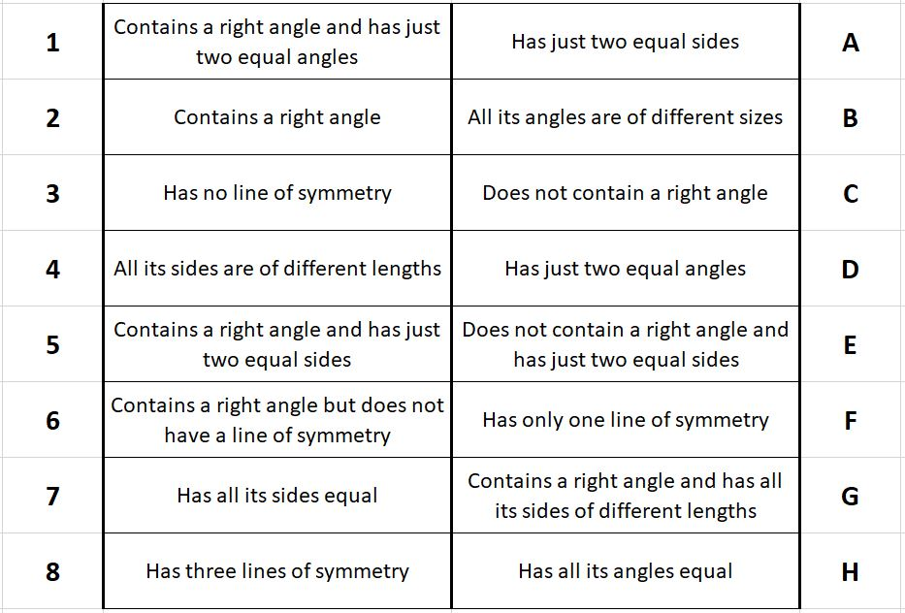

Slide 21
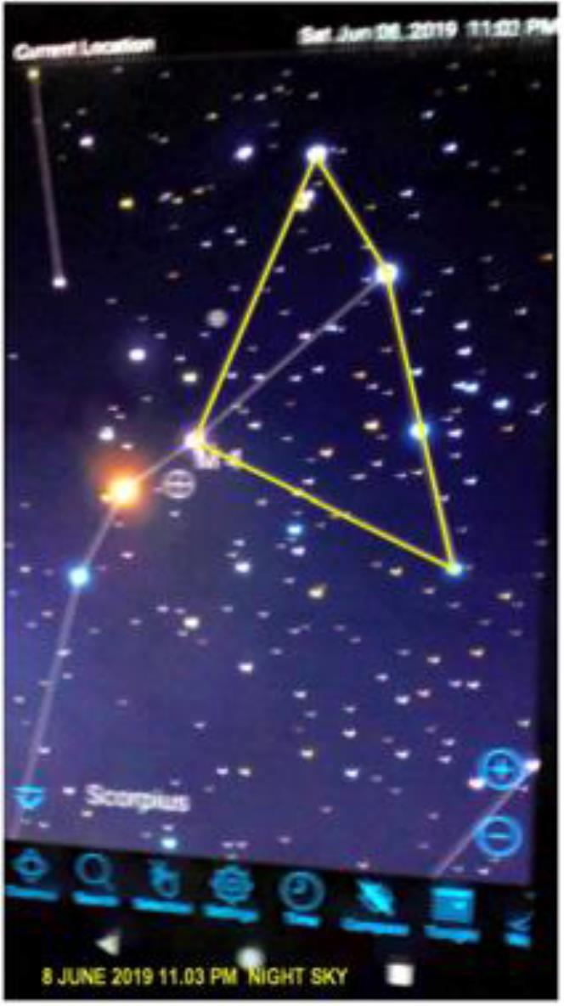
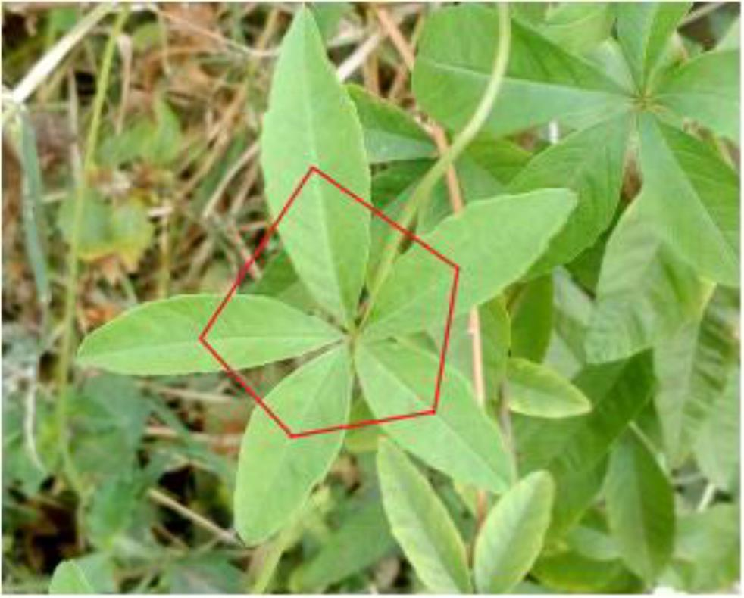
The centre point of these 5 leaves when joined gives a Pentagon ( 5 sides)
A constellation marked in the night sky above is in Quadrilateral formation.

Slide 22
A GAME
This game can be played against the computer, or against a friend. Players take it in turns to click on a dot on the grid - first player's dots will be blue and the second player's (or computer's) will be red. The winner is the first to have four dots that can be joined by straight lines to form a square. Squares can be any size and can be tilted. If you've played a few times against a friend, you might like to discuss your strategies, and then test them by playing against the computer. For an extra challenge, why not increase the size of the grid using the arrow buttons?
https://nrich.maths.org/square-it/

Slide 23
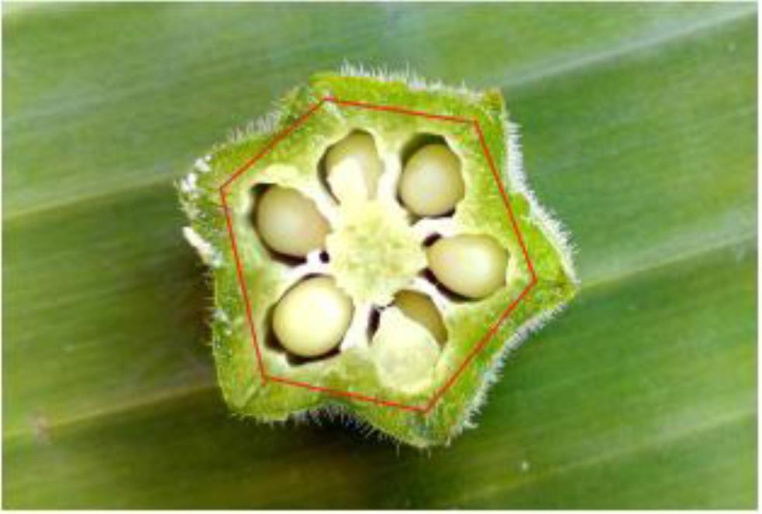
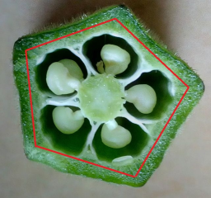
POLYGON
A cut lady’s finger reveals a characteristic Hexagon (6 sides)

Slide 24
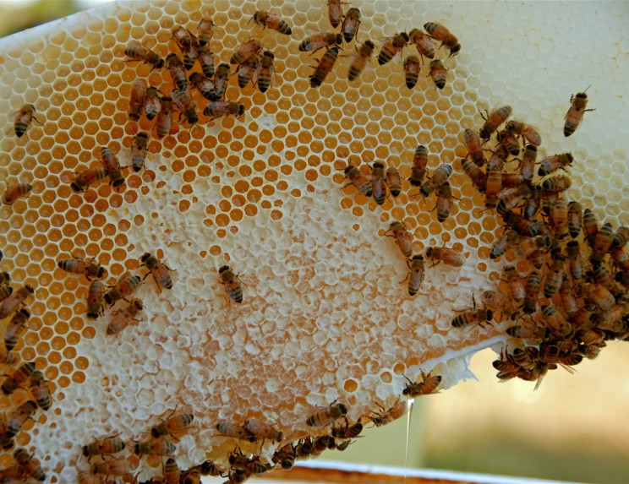
HEXAGONS IN NATURE

Slide 25
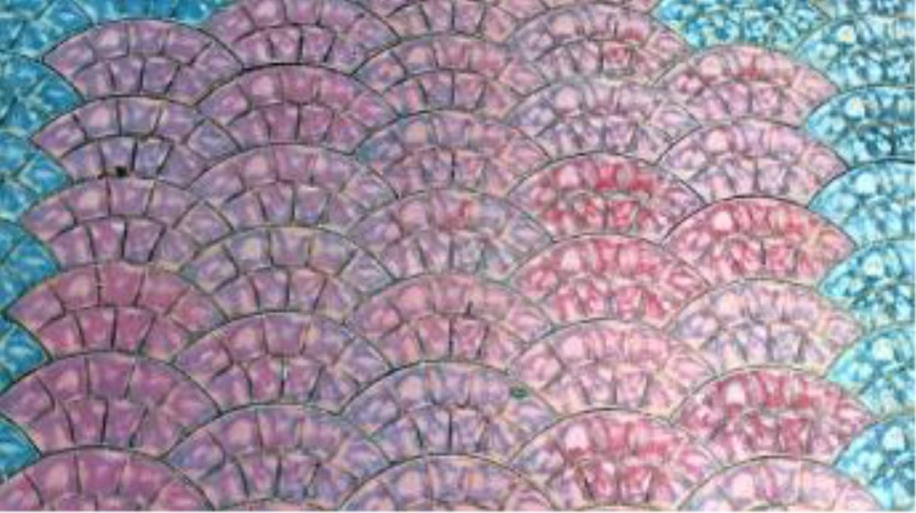
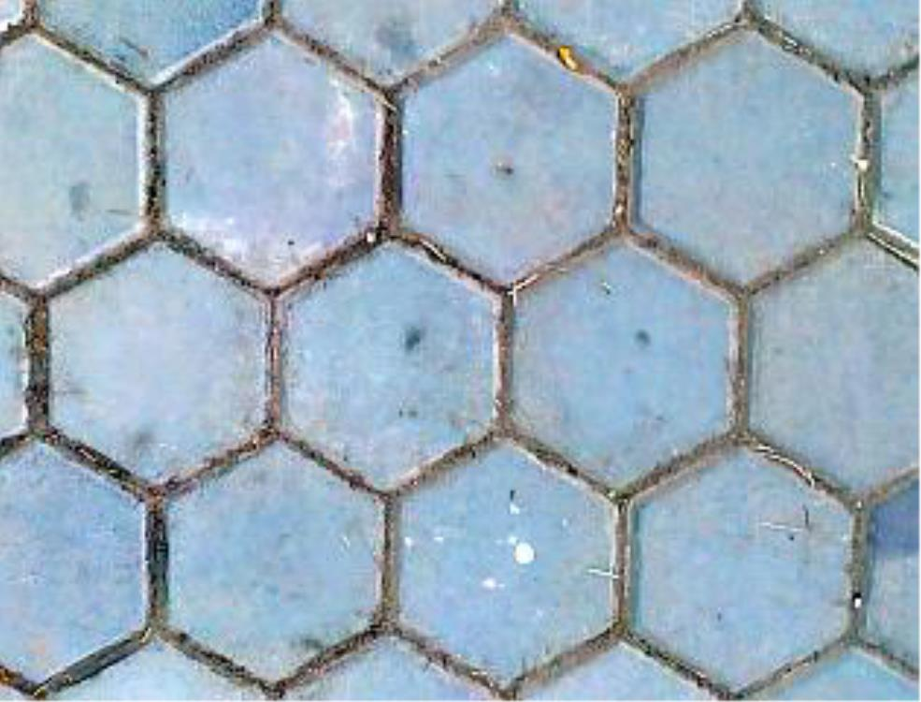
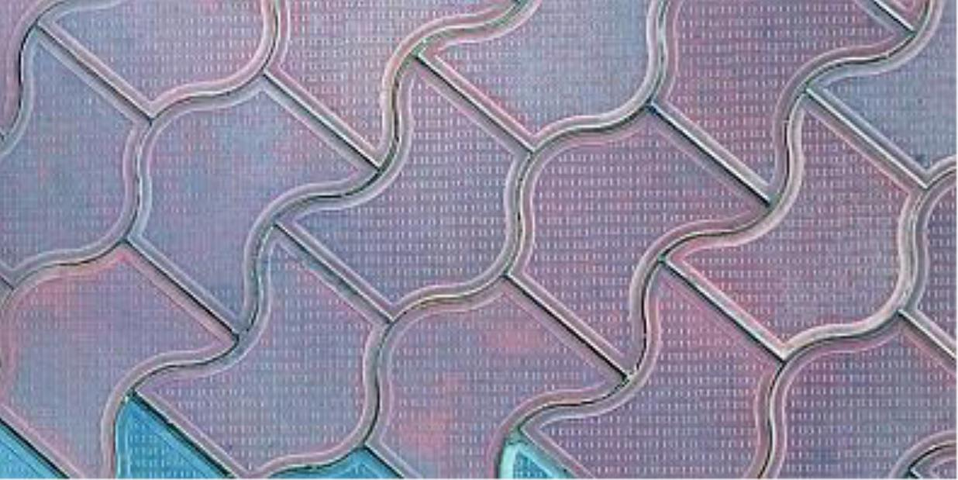
GEOMETRY IN TESELLATIONS
Some of these shapes are used in forming Tessellations in
designing floor tiles.

Slide 26
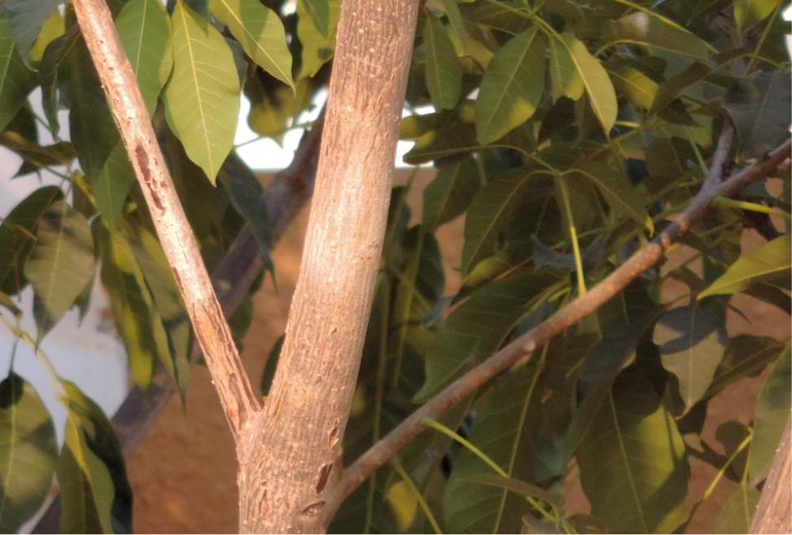
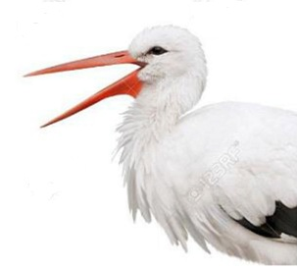
ANGLES
Observe the angles formed at the elbows, a bird opening its beak
and the trunk and branch of a tree.

Slide 27
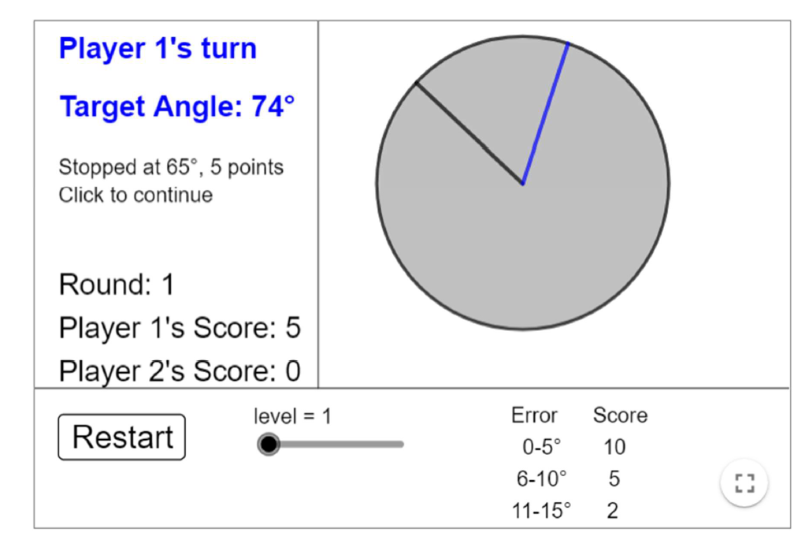
A GAME
Solving Together – Estimating Angles
https://nrich.maths.org/14445
This is a game for two players.
You take it in turns to estimate angles, and you score points based on how close you are to the target angle. Here is a screenshot showing the online version of the game, after Player 1 has had their first turn:

Slide 28
If you stop the rotating arm within 5° of the target, you score 10 points.
If you are between 6° and 10° of the angle, you score 5 points.
If you are between 11° and 15° of the angle, you score 2 points.
Player 1’s angle was 65°, which is 9° away from the target of 74°, so they
scored 5 points.
Take it in turns to estimate ten angles.
Can you score more than 50 points?
After you have played some rounds, you might like to discuss why you
find some angles easier to estimate than others.

Slide 29
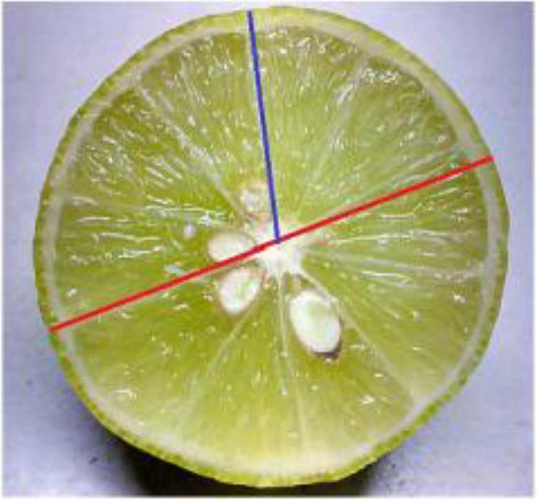
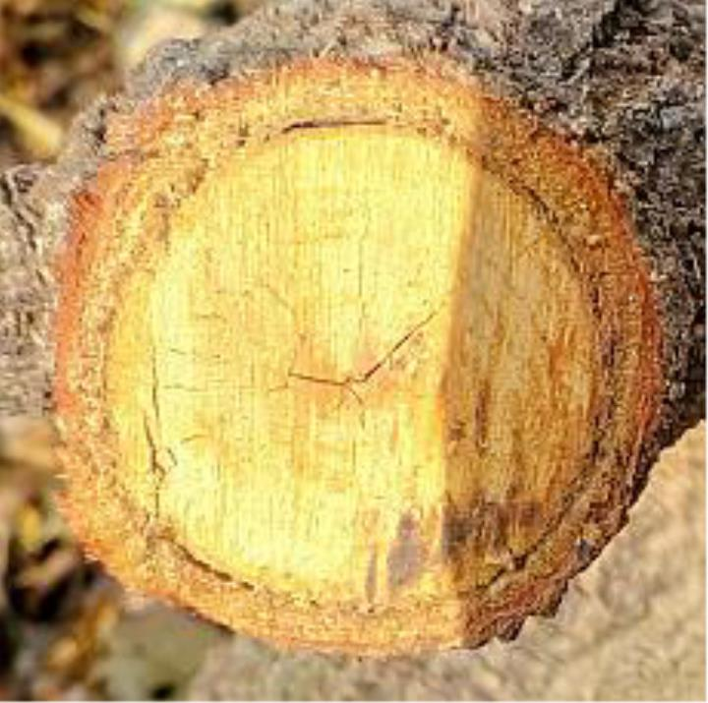
A CIRCLE
The circle is suggested by the shape of the full moon as seen by the naked eye, a cut orange, a cut tree.

Slide 30
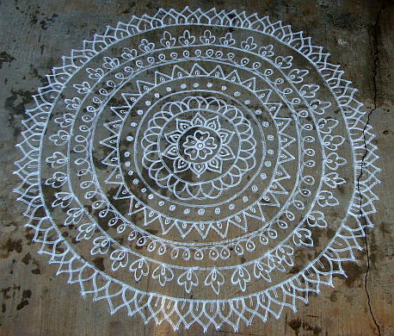
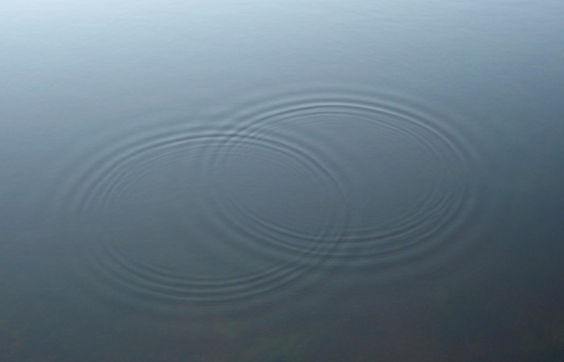
CIRCLES IN OUR DAILY LIFE

Slide 31
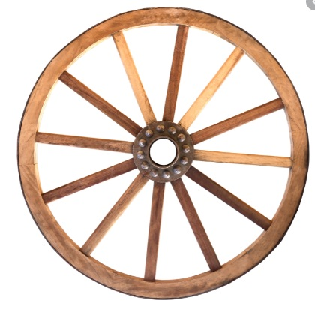
WHAT HELPED MAN TO MOVE FROM ONE PLACE TO ANOTHER?

Slide 32
HOW IS THIS MAN ABLE TO MOVE AROUND?
Video of man on square wheels

Slide 33
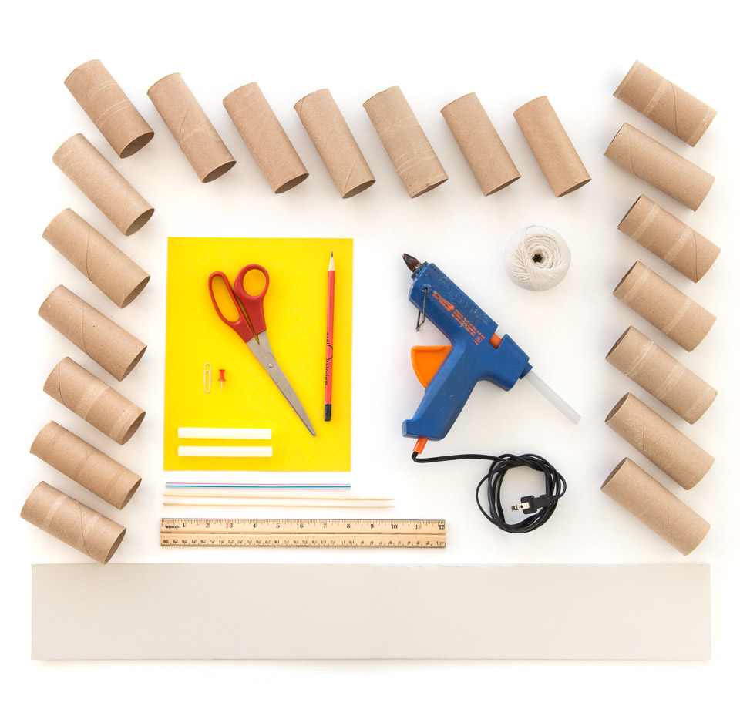
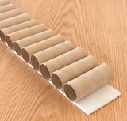
DO IT YOURSELF ACTIVITY
Square Wheels You may not be able to put a square peg in a round hole—but you can make a square wheel roll on a round road. Square wheels roll smoothly on a surface with bumps of the right size and shape.
Tools and Materials
About 20 cardboard toilet paper tubes
(all approximately the same diameter)
Foamboard, stiff cardboard, or
matboard to serve as a base for the
cardboard tubes, about 4 x 30 inches
(10 x 75 cm)
Hot-glue gun and glue sticks, Poster board or matboard, approximately 8 x 10 inches (20 x 25
cm), Scissors, Pencil or pen, Ruler, Pushpin, Drinking straw, Two bamboo skewers, Paper clip
String, about 12 inches (30 cm)
Using hot glue, attach a cardboard tube across one end of the base.
Continue gluing on tubes, with each tube just touching the one before it,
until you reach the other end of the base.

Slide 34
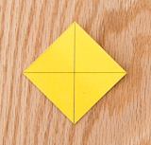
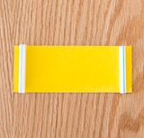
2. Measure the diameter of three or four of the toilet-paper rolls. The diameters should be approximately 1 11/16 inches (4.3 cm). If this is the case, cut four square wheels from the poster board, with sides of 2 inches (5 cm). If the diameter of your tubes is significantly different from this measurement, then make the
sides of the square wheels equal to 1.2 times that diameter. (See the Math Root below.)
3. Locate the center of each square wheel by drawing two diagonals, as shown in the photo below.
4. Use the pushpin to poke a small hole in the center of each square wheel, taking care not to bend or crease the wheel.
5. From the poster board, cut a rectangle measuring 2 x 5 inches (5
x 12 cm).
6. Cut two sections of straw, each 2 inches (5 cm) long.
7. Glue the straw sections to the rectangular piece of poster board 3/8 inch (1 cm) from
each end (see photo below). This assembly will be the body of a small cart.
SQUARE WHEEL

Slide 35
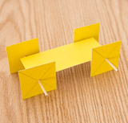
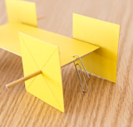
8. Cut the skewers into two 5-inch-long (12-cm) pieces, each with a point at one end. These will be axles. (If you can’t cut the skewers with the scissors, just break the skewers, or cut them with a utility
knife.)
9. Slide one of the square wheels onto a skewer until it’s about ¾ inch (2 cm) from the non-pointed end. Slide the pointed end through the straw, and then slide the other square wheel onto the
skewer. Adjust the wheels so they’re aligned with each other, and are fairly close to the edge of the cart. The wheel-and-axle assembly should turn freely in the straws. Assemble the other set of wheels the same way. When all the wheels are on, the cart should look like the photo below.
10. Use the pushpin to poke a hole between the straw and one end of the cart body, equidistant from the edges, as shown below. Put one end of the paper clip through the hole, and adjust until it’s positioned as shown in the photo below.

Slide 36
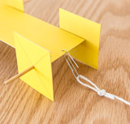
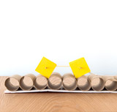
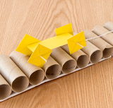
SQUARE WHEEL
11. Tie a loop in the end of the string, and place it on the paper clip
Place the cart at one end of the cardboard-tube “road" (see photo below). Make sure the wheels on each axle are aligned with each other. Also, be sure that the wheels are reasonably perpendicular to the axles and are not excessively tilted or wobbly. If they are, use a small amount of hot glue to hold them in place on the axle.
Pull gently on the string so the cart travels along the road. Notice that the cart rolls along smoothly and the axles stay at a reasonably constant height.

Slide 37
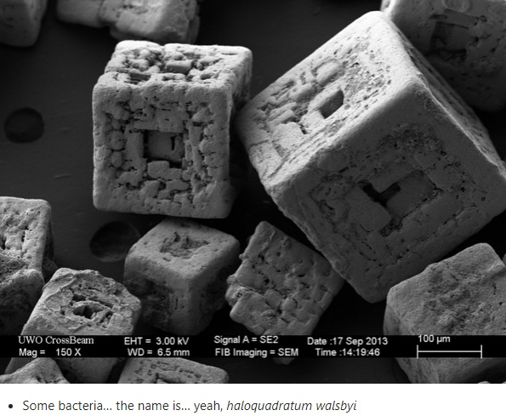
CUBES

Slide 38
CONES

Slide 39
GENERATING A CONE

Slide 40
CYLINDERS

Slide 41
GENERATING A CYLINDER

Slide 42
SPHERES

Slide 43
GENERATING A SPHERE

Slide 44
LET’S REVIEW
SOME CONCEPTS
POINT ,LINE SEGMENT,LINE,RAY
DIFFERENT TYPES OF LINES
DIFFERENT TYPES OF CURVES
DIFFERENT TYPES OF POLYGONS
ANGLES
CIRCLES
SPHERE
CYLINDER
CUBE
CONE

Slide 45
GEOMETRY IS EVERYWHERE

Slide 46
THANKS!
Any questions?

Slide 47
EXTRA RESOURCES
2
1.For more games and activities
https://nrich.maths.org/8647
2.For shapes in Nature
https://www.cuemath.com/learn/shapes-in-nature/
(Watch the embedded video)

